Slide 1
What are the Consequences for the User When It Fails?

Slide 2
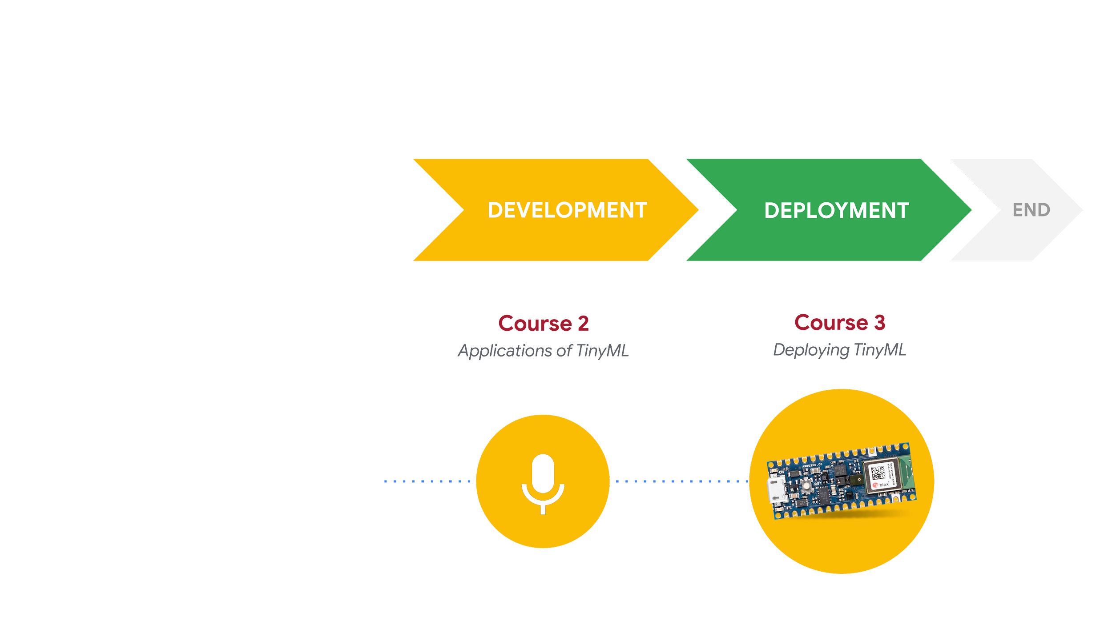
Responsible AI: Human-Centered Design
DESIGN
START
Course 1
Fundamentals of TinyML
What am I building?
Who am I building this for?
What are the consequences for the user if it fails?

Slide 3
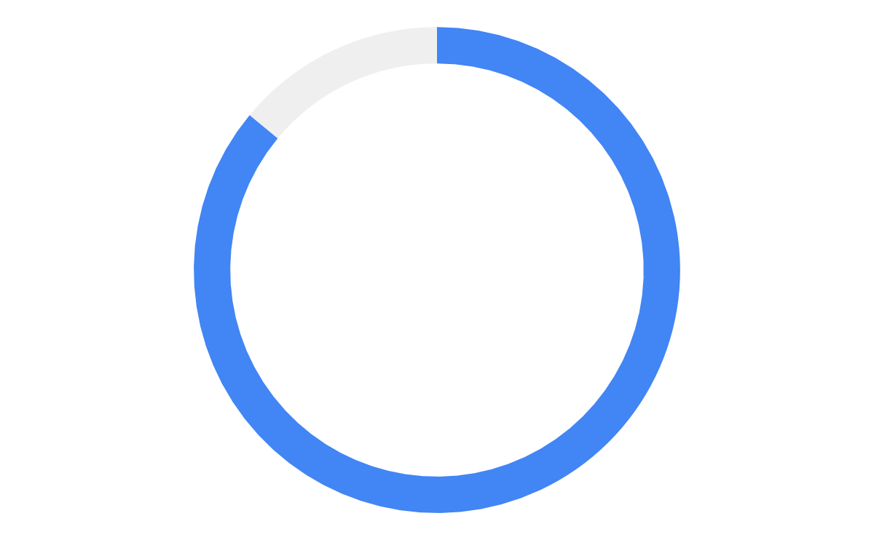
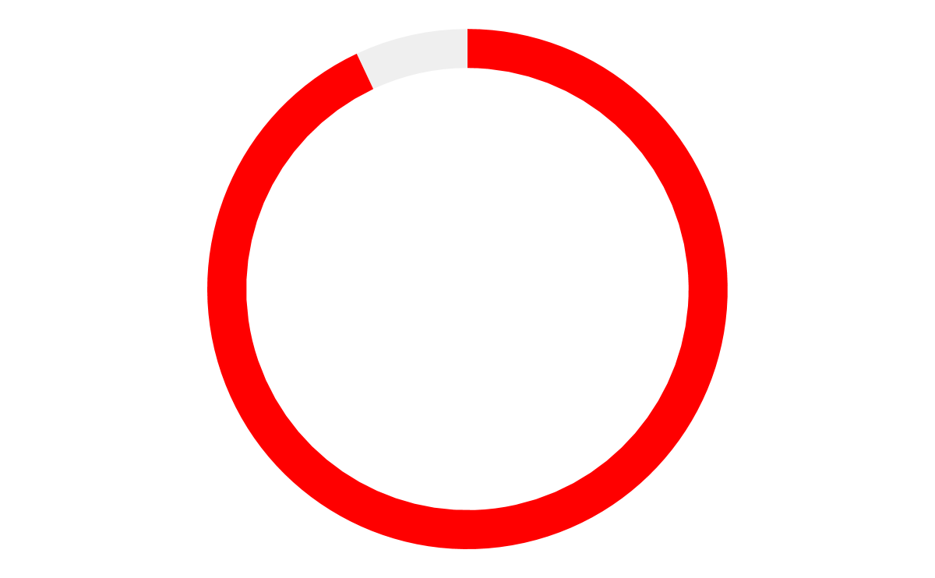
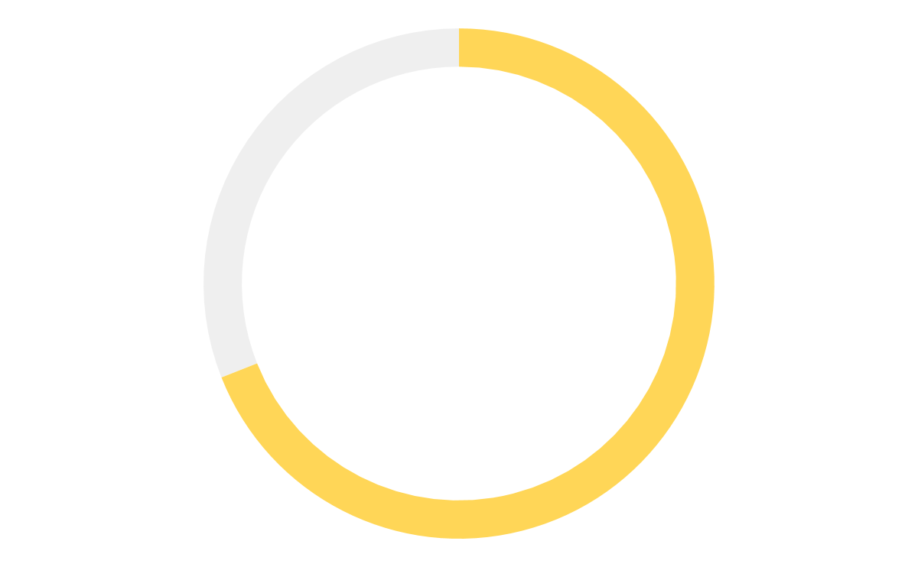
AI isn’t perfect
Accuracy of Voice Assistants
Speech Commands
86%
93%
69%
Google Assistant | Siri | Alexa
Source: https://loupventures.com/annual-digital-assistant-iq-test/
Notes:
https://loupventures.com/annual-digital-assistant-iq-test/

Slide 4
What are the consequences for the user?

Slide 5
When AI succeeds
 | Actual Disease = Yes | Actual Disease = No
Predicted Disease = Yes | True Positive | False Positive
Predicted Disease = No | False Negative | True Negative

Slide 6
When AI fails
 | Actual Disease = Yes | Actual Disease = No
Predicted Disease = Yes | True Positive | False Positive
Predicted Disease = No | False Negative | True Negative

Slide 7
Two types of error
 | Actual Disease = Yes | Actual Disease = No
Predicted Disease = Yes | True Positive | False Positive Type 1 Error
Predicted Disease = No | False Negative Type 2 Error | True Negative

Slide 8
2 types of error?
2 ways to optimize!

Slide 9
Precision
If we optimize our model for high precision
We minimize Type 1 Errors
(fewer false positives)

Slide 10
Precision
If we optimize our model for high precision
We minimize Type 1 Errors
(fewer false positives)
We increase Type 2 Errors
(more false negatives)
Notes:
(good when false positive is more costly than missed detection)

Slide 11
Recall
If we optimize our model for high recall
We minimize Type 2 Errors
(fewer false negatives)

Slide 12
Recall
If we optimize our model for high recall
We minimize Type 2 Errors
(fewer false negatives)
We increase Type 1 Errors
(more false positives)
Notes:
good when false negative is more costly e.g. cost of overlooking cases is more than cost of false alarms

Slide 13
Tension between Precision and Recall
1.0
1.0
High precision
High recall
Classification threshold
Classification threshold
Actually spam
False positive
Actually not spam
False negative
0.0
0.0
Notes:
Precision and recall are in tension
improving precision typically reduces recall and vice versa
Insert visualization of changing threshold

Slide 14
Which measure is more important?
It depends!
Q:
A:

Slide 15
4 Key Questions
1
Who are the key stakeholders (both direct and indirect)?
2
What are the consequences of a Type 1 error?
3
What are the consequences of a Type 2 error?
4
Which type of error would be most harmful?

Slide 16
Which measure is more important?
4
Which type of error would be most harmful?
If Type 1 errors are most harmful,
then precision is more important
If Type 2 errors are most harmful,
then recall is more important

Slide 17


Spam Filtering
1
Key stakeholders?
user with email account; user’s correspondents
2
Type 1 error?
user doesn’t receive important email, correspondent is unable to communicate with user
3
Type 2 error?
user sees spam in email inbox
4
Most harmful?
Type 1 errors most harmful to stakeholders
Notes:
Choose higher precision!!

Slide 18
Spam Filtering
1
Key stakeholders?
user with email account; user’s correspondents
2
Type 1 error?
user doesn’t receive important email, correspondent is unable to communicate with user
3
Type 2 error?
user sees spam in email inbox
4
Most harmful?
Type 1 errors most harmful to stakeholders
optimize for higher precision
Notes:
Choose higher precision!!

Slide 19
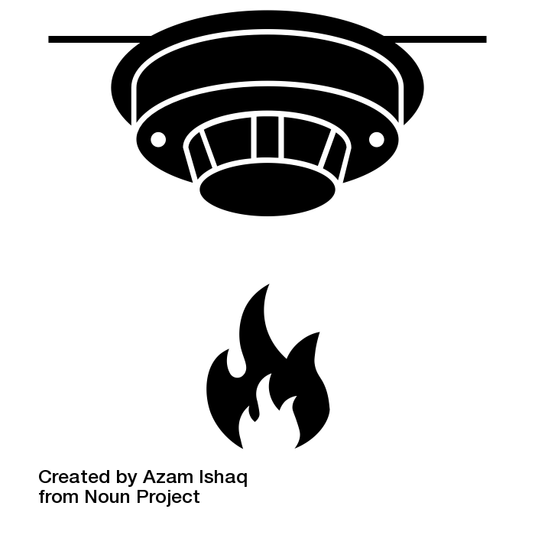

Smart Smoke Detector
1
Key stakeholders?
user of device; members of household; neighbors
2
Type 1 error?
user / members of household annoyed by false alarms
3
Type 2 error?
user / members of household don’t evacuate during fire; neighbors have less time to respond as fire spreads
4
Most harmful?
Type 2 errors most harmful to stakeholders
Notes:
Choose higher recall!

Slide 20
Smart Smoke Detector
1
Key stakeholders?
user of device; members of household; neighbors
2
Type 1 error?
user / members of household annoyed by false alarms
3
Type 2 error?
user / members of household don’t evacuate during fire; neighbors have less time to respond as fire spreads
4
Most harmful?
Type 2 errors most harmful to stakeholders
optimize for higher recall
Notes:
Choose higher recall!

Slide 21



Home Surveillance
User Notified
Police Notified
Notes:
(same classifier, same application, but different feedback/stakeholders)
https://thenounproject.com/search/?q=home+security&i=2401779

Slide 22
Home Surveillance
User Notified
Police Notified
Type 2 error is most harmful
higher recall is preferred
Notes:
(same classifier, same application, but different feedback/stakeholders)
https://thenounproject.com/search/?q=home+security&i=2401779

Slide 23
Home Surveillance
User Notified
Police Notified
Type 1 error harms indirect stakeholders
slightly higher precision is preferred
Type 2 error is most harmful
higher recall is preferred
Notes:
(same classifier, same application, but different feedback/stakeholders)
https://thenounproject.com/search/?q=home+security&i=2401779

